Slide 1

BLACK & GOLD DAY!
February 18, 2013

Slide 2
SCHEDULE OF EVENTS
1:30 p.m. University Overview
2:30 p.m. Campus Tour
3:30 p.m. Academic & Campus Life Fair
4:30 p.m. Dinner-Marketplace

Slide 3
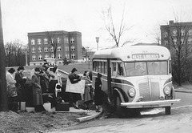
WHO WE ARE
Public Undergraduate & Graduate Institution
Celebrating our 175th year (oldest higher education public institution in WV-founded in 1837)
Fall 2012 – 2,795 enrolled students
7th Consecutive Year of Enrollment Increase
Average Class Size is 25 students

Slide 4
WHO WE ARE
Fall 2012 Demographics
Enrolled Students from 46 of the 55 WV Counties
Enrolled Students from 25 States and
Washington D.C.
Enrolled Students from 26 Countries (including the U.S.)
Roughly 50% of our students live in Campus owned housing (84% of freshman live on campus)

Slide 5

WHO ARE WE?
Five Academic Colleges: Arts & Communications, Business, Education, Liberal Arts & Sciences, and School of Prof. Studies
Offer 16 NCAA Division II Sports (Women’s Soccer & Men’s Club Lacrosse added)
Course Offerings at Highlands Center
Over 60 Student Clubs/Organizations
Facilities Update: Shaw Hall Renovation, Health Science Building

Slide 6

WHAT WE DO
Offer quality
programs
Provide an
exceptional value
Safe and caring environment

Slide 7

OFFER QUALITY PROGRAMS
Over 50 major degree programs are available (new programs-Social Work, Athletic Training, Appalachian Studies, Phys. Assistant)
Freshman Laptop Program
2nd Highest Retention Rate for all
WV Public Colleges
2nd Highest Graduation Rate for all WV Public College

Slide 8

EXCEPTIONAL VALUE
90% of West Liberty students receive some type of financial aid
Metro Rate
$4.5 million dollars awarded annually in scholarships

Slide 9

PROVIDE AN EXCEPTIONAL VALUE
Tuition & Fees: $5,530 In-State
  $11,236 Metro Rate
  $13,140 Out of State
Room & Board: $8,200
NOTE: Different Tuition Charges for some majors

Slide 10
PROVIDE AN EXCEPTIONAL VALUE
Average tuition/fee cost for a 4-year public college
          $8,655 in state and
          $21,706 out of state
Average tuition/fees at a 4-year private college
          $29,056
Average room/board in 2012-13
          $9,205 at public institutions
          $10,462 at private institutions
*Figures are from the College Board Trends in College Pricing 2012

Slide 11
PROVIDE AN EXCEPTIONAL VALUE
Metro Rate provides a reduction in tuition and fees for students residing in out of state neighboring counties
Current reduction is approximately $2100 per year
Ohio: Counties west to Columbus and north to Cleveland
Pennsylvania: Allegheny, Beaver, Butler, Greene, Washington, Westmoreland
  Maryland: Allegany, Frederick, Garrett, Montgomery, Washington
  Virginia: Clarke, Frederick, Loudoun, Shenandoah, Warren

Slide 12

SCHOLARSHIPS
Scholar Program: Scholarship Program for Students with a 3.75 GPA and at least 22 ACT/1020 SAT. Students designated as Elbin (27 ACT or higher), Presidential (24-26 ACT), or Foundation (22-23 ACT) Scholars
ELBIN SCHOLARS with a 4.00 gpa (unweighted) and a 30 ACT composite score receive full scholarship to cover tuition, most fees, room and board.
ELBIN SCHOLARS – Metro or
Out-of-State receive $12000 a year
ELBIN SCHOLARS – In-State
receive $4000 a year

Slide 13
SCHOLARSHIPS CONTINUED
PRESIDENTIAL SCHOLAR-$3000 a year
FOUNDATION SCHOLAR-$2000 a year
OTHER SCHOLARSHIPS
-BLACK & GOLD SCHOLARSHIP-$1000 a year for 4 years (22 ACT/3.5 to 3.74 gpa)
-PROMISE PLUS-$1000 a year for 4 years, unless student has another scholarship -UNIVERSITY SCHOLARSHIP-$2000 a year for 3 years for transfer students with 3.25 gpa or higher

Slide 14


SCHOLARSHIPS CONTINUED
Marching Band Scholarships:
For students participating in the marching band
Arts & Communications Scholarships: Awards determined by Academic Departments
Athletic Scholarships: Awards determined by head coaches
American Ambassador Program

Slide 15
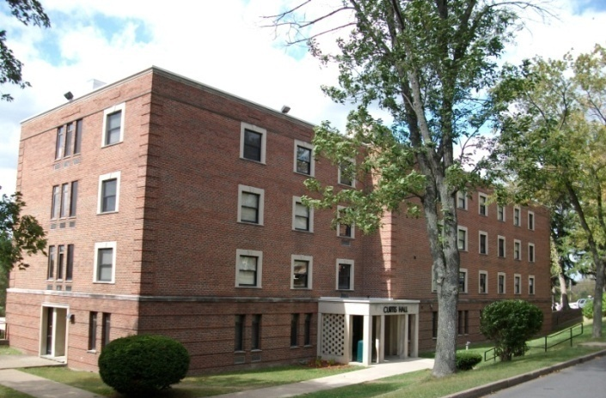
SAFE & CARING ENVIRONMENT
24 Hour – 7 Day a Week Campus Police Department
Ranked as the Safest 4 yr Public Campus in WV
by stateuniversity.com
Secure Residence Hall Access (Topper Card), Alarms and Security Cameras
TopperNet Emergency Text System
Academic Advisors
First Year Experience Course
19:1 Student-Faculty Ratio
Free Tutoring

Slide 16

SAFE & CARING ENVIRONMENT
Career Services
Counseling Services
ADA Accommodations
Retention Specialist
MAP Works Program
Residential Life Program
Full-time Campus Activities Coordinator
International Studies Center
Health Services Office
January 2013 WLU became Tobacco Free

Slide 17

WHAT IS FINANCIAL AID?
Scholarships (academic, talent-based, athletic or need based)
Grants (Federal and State)
Loans (Federal, parent, alternative and institutional)
Student Employment (Federal work study and institutional)

Slide 18
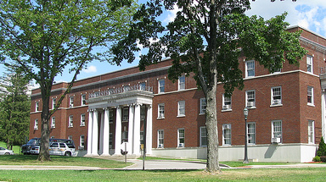
How Do I Apply?
The FAFSA (www.fafsa.gov) must be completed to apply for:
  Federal and State Grants (Pell, SEOG, TEACH, WVHEG, PHEAA)
  Federal Loans
  Federal Work-Study (WLU requires an additional institutional form)
  *Some state agencies may require additional paperwork

Slide 19

APPLYING CONTINUED
Admissions Application
Institutional Scholarship Applications
Third Party Applications
IMPORTANT: Check Institutional and State Deadlines

Slide 20

DEADLINES
WLU FAFSA priority deadline: April 15
WLU scholarships: awarded on a rolling basis for students accepted
by June 15.
Early awards to Scholars during November
At WLU, priority for scholarships given to students accepted by January 15th

Slide 21

ADMISSION PROCEDURES
Submit Admission’s Application
Submit High School Transcript and/or College Transcript
Submit Standardized Test Scores (may be on high school transcript)
Submit Student Health Form
Submit Transfer Clearance Form (if a transfer student)

Slide 22

ADMISSION REQUIREMENTS
High School Graduates
  2.00 Grade point average
  Minimum of 18 ACT (870 SAT)
  Curricular Requirements
4 units of English
4 units of Mathematics (3 must be Algebra 1 or higher)
3 units of Social Studies (including US History)
3 units of Science (all lab sciences)
2 units of Foreign Language
1 unit of Fine Arts

Slide 23


ADMISSION REQUIREMENTS
Transfer Students
  2.00 minimum college GPA required
  If less than 28 credit hours earned, also need HS
  transcript
  Transfer Clearance Form

Slide 24

QUESTIONS REGARDING:
ENROLLMENT SERVICES
Financial Aid: 304-336-8016
Admissions: 304-336-8076
Toll Free: 1-866-WESTLIB
WESTLIBERTY.EDU

