Slide 1

Ambassador Academy
Spring 2012

Slide 2
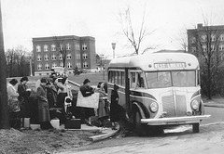
WHO ARE WE?
Public Undergraduate & Graduate Institution
Celebrating our 175th year (oldest higher education public institution in WV-founded in 1837)
Fall 2011 – 2,790 enrolled students
6th Consecutive Year of Enrollment Increase
Average Class Size is 25 students

Slide 3
WHO ARE WE?
Enrolled Students from 44 of the 55 WV Counties
Enrolled Students from 23 States and
Washington D.C.
Enrolled Students from 23 Countries (including the U.S.)
Roughly 50% of our students live in Campus owned housing (80% of freshman live on campus)

Slide 4

WHO ARE WE?
Five Academic Colleges: Arts & Communications, Business, Education, Liberal Arts & Sciences
Offer 15 NCAA Division II Sports (Women’s Club Soccer & Men’s Club Lacrosse added in 2011-12)
Course Offerings at Highlands Center
Over 60 Student Clubs/Organizations
Facilities Update: Shaw Hall Renovation, Health Science Building

Slide 5

WHAT DO WE DO
AT WEST LIBERTY?
Offer quality programs
Provide an affordable education
Safe and caring environment

Slide 6
OFFER QUALITY PROGRAMS
Over 30 academic programs are recognized nationally or have national accreditation
Over 50 major degree programs are available
This includes Health Sciences (Dental Hygiene & Nursing), Teacher Education, Business, Biology, Graphic Design, Arts & Communications, and Broadcasting
Freshman Laptop Program
2nd Highest Retention Rate for all WV Public Colleges
Creation of the Honors College

Slide 7

PROVIDE AN AFFORDABLE EDUCATION
89% of West Liberty students receive some type of financial aid
Metro Rate for Bordering Counties
$4.5 million dollars awarded annually in institutional scholarships

Slide 8
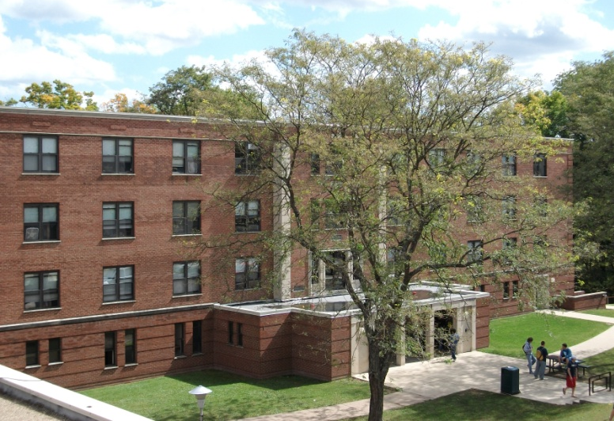
PROVIDE AN AFFORDABLE EDUCATION
Tuition & Fees: $5,266 In-State
  $10,500 Metro Rate
  $13,140 Out of State
Room & Board: $7,710
NOTE: Different Tuition Charges for some majors

Slide 9
PROVIDE AN AFFORDABLE EDUCATION
According to The College Board in 2011-12, the average tuition/fee cost for a 4-year public college was $8,244 in state and $20,770 out of state
Average tuition/fees at a 4-year private college was $28,500
Average room/board in 2011-12 was $8,887 at public institutions & $10,089 at private institutions
*Figures are from the College Board Trends in College Pricing 2011

Slide 10
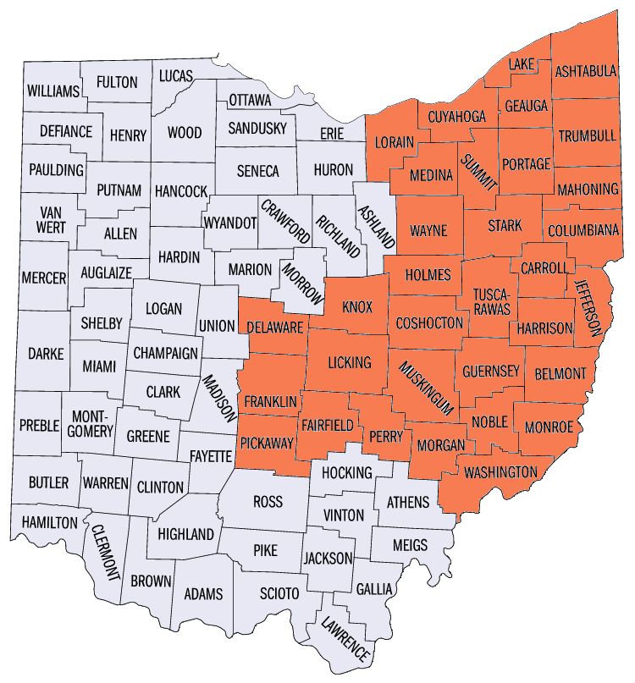
PROVIDE AN AFFORDABLE EDUCATION
Metro Rate provides a reduction in tuition and fees for students residing in out of state neighboring counties
Current reduction is approximately $2500 per year-Expanding in 2012-13
Ohio: Counties west to Columbus and north to Cleveland
Pennsylvania: Allegheny, Beaver, Butler, Greene, Washington, Westmoreland
  Maryland: Allegany, Frederick, Garrett, Montgomery, Washington
  Virginia: Clarke, Frederick, Loudoun, Shenandoah, Warren

Slide 11

SCHOLARSHIPS
Scholar Program: Scholarship Program for Students with a 3.75 GPA and at least 22 ACT/1020 SAT. Students designated as Elbin (27 ACT or higher), Presidential (24-26 ACT), or Foundation (22-23 ACT) Scholars
Elbin Scholars with 4.00 gpa (unweighted) receive full scholarship to cover tuition, mandatory fees, room and board. A 30 ACT composite score will also be required beginning Fall 2013
PROMISE Plus Scholarship
Black & Gold Scholarship
University Scholarship

Slide 12
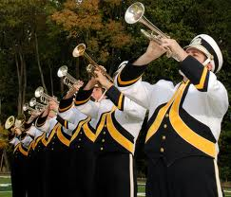
SCHOLARSHIPS CONTINUED
Marching Band Scholarships:
For students participating in the marching band
Arts & Communications Scholarships: Awards determined by Academic Departments
Athletic Scholarships: Awards determined by head coaches

Slide 13
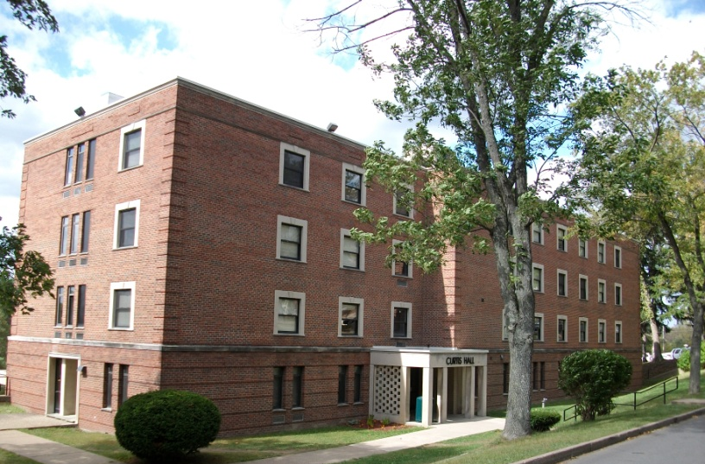
SAFE & CARING ENVIRONMENT
24 Hour – 7 Day a Week Campus Police Department
Secure Residence Hall Access (Topper Card), Alarms and Security Cameras
TopperNet Emergency Text System
Academic Advisors
First Year Experience Course
18:1 Student-Faculty Ratio
Free Tutoring

Slide 14
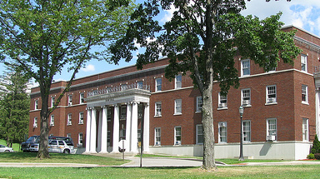
SAFE & CARING ENVIRONMENT
Career Services
Counseling Services
ADA Accommodations
Retention Specialist
MAP Works Program
Full-time Campus Activities Coordinator
Residential Life Program
Health Services Office

Slide 15

WHAT IS FINANCIAL AID?
Scholarships (academic, talent-based, athletic or need based)
Grants (Federal and State)
Loans (Federal, parent, alternative and institutional)
Student Employment (Federal work study and institutional)

Slide 16

WHERE DOES IT COME FROM?
U.S. Department of Education
State Higher Education Agencies
Institutions
Third parties such as private foundations, banks, civic organizations, etc.

Slide 17
How Do I Apply?
The FAFSA (www.fafsa.gov) must be completed to apply for:
  Federal and State Grants (Pell, SEOG, TEACH, WVHEG, PHEAA)
  Federal Loans
  Federal Work-Study
  *Some state agencies may require additional paperwork

Slide 18
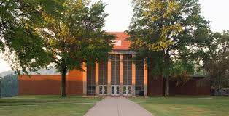
APPLYING CONTINUED
Admissions Application
Institutional Scholarship Applications
Third Party Applications
IMPORTANT: Check Institutional and State Deadlines

Slide 19
DEADLINES
WLU FAFSA priority deadline: March 1st
WLU scholarships: awarded on a rolling basis for accepted students
Early awards to Scholars during 1st week of November
At WLU, priority for scholarships given to students accepted by January 15th

Slide 20
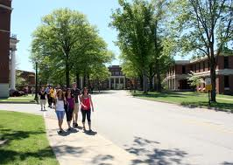
ADMISSION PROCEDURES
Submit Admission’s Application
Submit High School Transcript and/or College Transcript
Submit Standardized Test Scores (may be on high school transcript)
Submit Student Health Form
Submit Transfer Clearance Form (if a transfer student)

Slide 21

ADMISSION REQUIREMENTS
High School Graduates
  2.00 Grade point average
  Minimum of 18 ACT (870 SAT)
  Curricular Requirements
4 units of English
4 units of Mathematics (3 must be Algebra 1 or higher)
3 units of Social Studies (including US History)
3 units of Science (all lab sciences)
2 units of Foreign Language
1 unit of Fine Arts

Slide 22

ADMISSION REQUIREMENTS
Transfer Students
  2.00 minimum college GPA required
  If less than 28 credit hours earned, also need high school transcript
  Transfer Clearance Form

Slide 23

QUESTIONS REGARDING:
Financial Aid: 304-336-8016
Housing/Residence Life: 304-336-8345
Admissions: 304-336-8076
Toll Free: 1-866-WESTLIB
WESTLIBERTY.EDU

